Slide 1
Journey to Auto Route in Flutter
Cavin Macwan

Slide 2
A little bit about me
🔤 My name is Cavin Macwan
🎓 Flutter Developer (at 7Span)
✍️ Love to write blogs about Flutter on Medium
🗣️ Speaker
💙 Finished #100DaysWithFlutter
🏀 Basketball Player
🤩 Google “Cavin Macwan” to see my people card 😊

Slide 3
What are we gonna cover today?
01
02
03
Why Auto Route? 🤔
Features
Demo
What is the actual reason to use Auto Route
See all the features which Auto Route Provides
I won’t let you all go without a demo of Auto Route😉

Slide 4
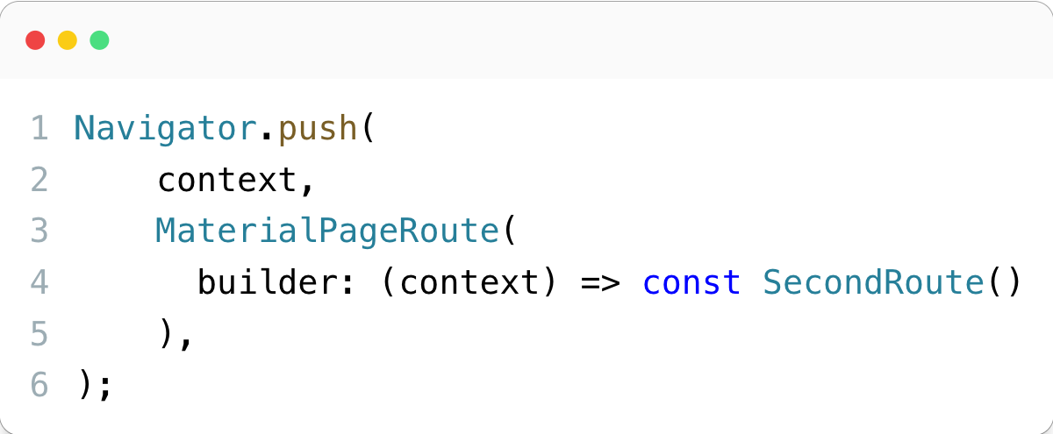
Old Times

Slide 5
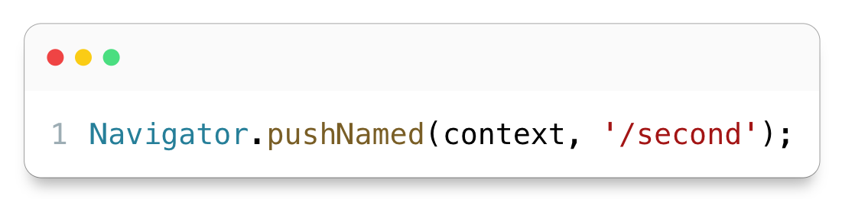
With the named routes

Slide 6
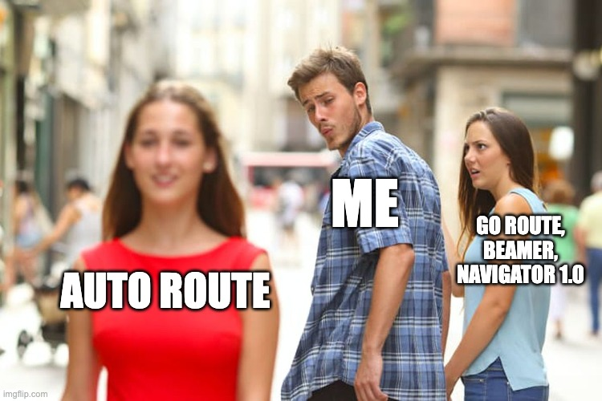

Slide 7
01
Why Auto Route?

Slide 8
What was wrong with the Navigator 1.0? 🤔
We used to doing navigation using push and pop in Flutter.
In Navigator 1.0, we used to do:
Navigation Using Push and Pop 💥
Web support is poor 🫣
We we only able to control some amount of Routes 😕
Nested navigation was a nightmare 👻
We have to use the old imperative way of routing 👨‍🦳

Slide 9
Web Problem Video

Slide 10


Imperative vs Declarative
Tell what to do and how to do
Only tell what to do

Slide 11

Conclusion: Navigator 1.0 won’t be able to tackle everything

Slide 12
What Flutter did to solve this issue?
Released a new document
Introduce a declarative API to set the history stack of the Navigator and a new Router widget to configure the Navigator based on app state and system events.

Slide 13
Was it able to solve the issue? 🤔
Short answer: No ❌
Long Answer: Na, No, Nai, Nakko, Ille ❌ 🙅‍♂️

Slide 14
Current Scenario
Go route
Auto Route
Beamer
I don’t like the docs 📝
All rounder
Comes with a lot of Boilerplate

Slide 15
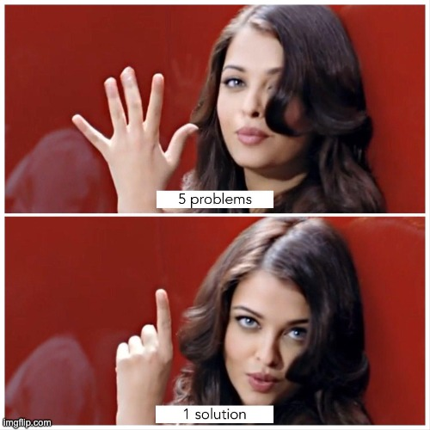
But which 5 major problems ?

Slide 16
Auto Route aims to
Able to modify the whole stack
Flutter Web Support
Declarative way
Backwards compatible

Slide 17

And the 5th one is…
Code generation

Slide 18
Features of Auto Route
Flow Routing
Nested Routes
Go with the flow 🪁
Wildcard Matching
Nest nest nest…
Don’t go too wild 🐯
And so on…
Path Parameters
This list won’t end if we talk about all the features 😅
Route Guards
Along with query parameters ⁉️
Guard your own routes 🔒

Slide 19

Thoda practical bhi dikha do

Slide 20
WildCard Matching
Video

Slide 21
Nested Routes
Video

Slide 22
Path/Query Parameters
Video

Slide 23
—Not by me
Anyone can write a code which computer can understand. The quality of your code is tested when a developer is able to understand your code.

Slide 24



Follow me on
LinkedIn and Twitter
cavin-macwan
cavin_1910

Slide 25


Join Our Community

Slide 26
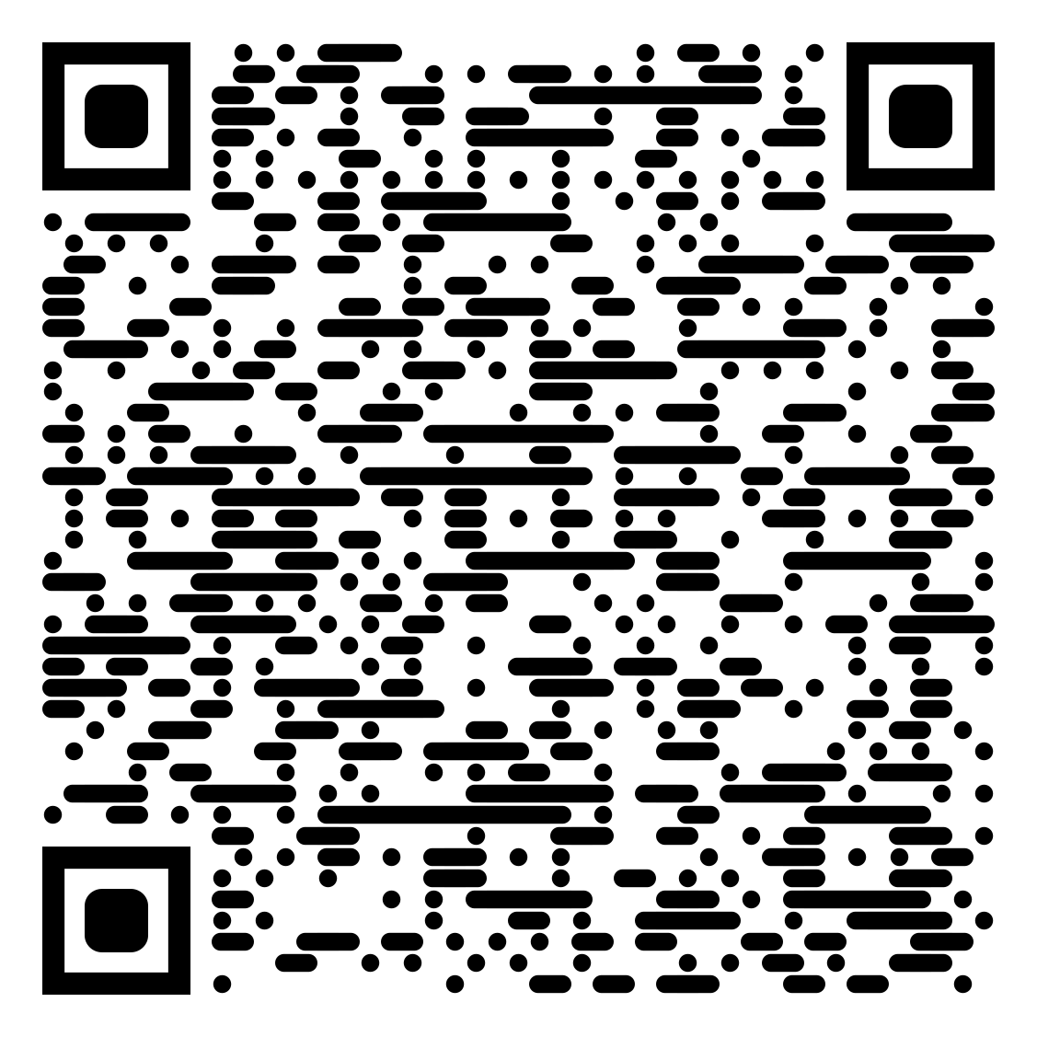

If you want to learn more about Auto Route
You can read my whole series about Auto Route on Medium:
You can also checkout the whole source code on GitHub by this QR code

